Slide 1
Limitations of algorithmic power
The power of algorithms is not unlimited
Some problems can not be solved by any algorithms
Some can be solved algorithmically but not in polynomial time
Even when problems can be solved in polynomial time by algorithms, there are usually lower bounds on the efficiency of algorithms

Slide 2
Limitations of algorithmic power
Lower bound:
an estimate on a minimum amount of work needed to solve a given problem
Examples:
number of comparisons needed to find the largest element in a set of n numbers
number of comparisons needed to sort an array of size n
number of comparisons necessary for searching in a sorted array
number of multiplications needed to multiply two n-by-n matrices

Slide 3
Lower Bounds (cont…)
The efficiency of an algorithm can be looked into two different ways
By establishing the asymptotic efficiency class i.e., obtaining and comparing upper bound with other class of algorithms. Ex: Bubble sort - O(n² ) and Tower of Hanoi- O(2^{n}) but, comparison has to be avoided because these two problems solve different problems
By establishing the efficiency class of solving the same problem with different methods. Ex: Bubble sort- O(n²), quick sort - n log n, so quick sort is efficient.

Slide 4
Lower Bounds (cont…)
Lower bound can be
an exact count
an efficiency class (Ω)
Tight lower bound: there exists an algorithm with the same efficiency as the lower bound
Problem Lower bound Tightness
sorting Ω(nlog n) yes
searching in a sorted array Ω(log n) yes
element uniqueness Ω(nlog n) yes
n-digit integer multiplication Ω(n) unknown
multiplication of n-by-n matrices Ω(n²) unknown

Slide 5
Methods for Establishing Lower Bounds
trivial lower bounds
information-theoretic arguments (decision trees)
adversary arguments
problem reduction

Slide 6
Trivial Lower Bounds
Trivial lower bounds: based on counting the number of items that must be processed in input and generated as output
Examples
finding max element
polynomial evaluation
sorting
element uniqueness
Hamiltonian circuit existence

Slide 7
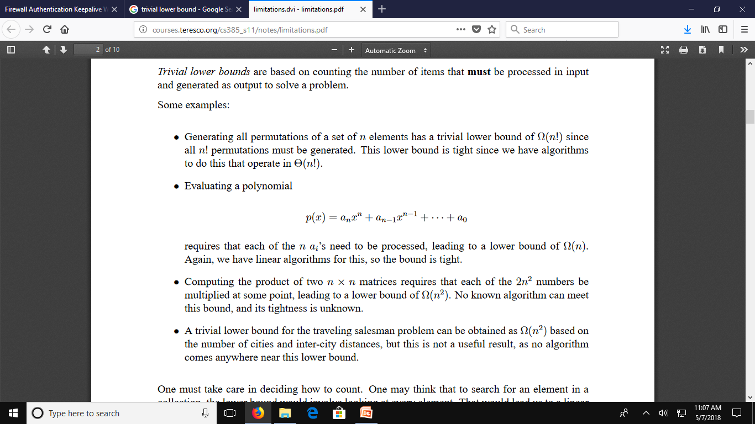
Trivial Lower Bounds: Examples

Slide 8
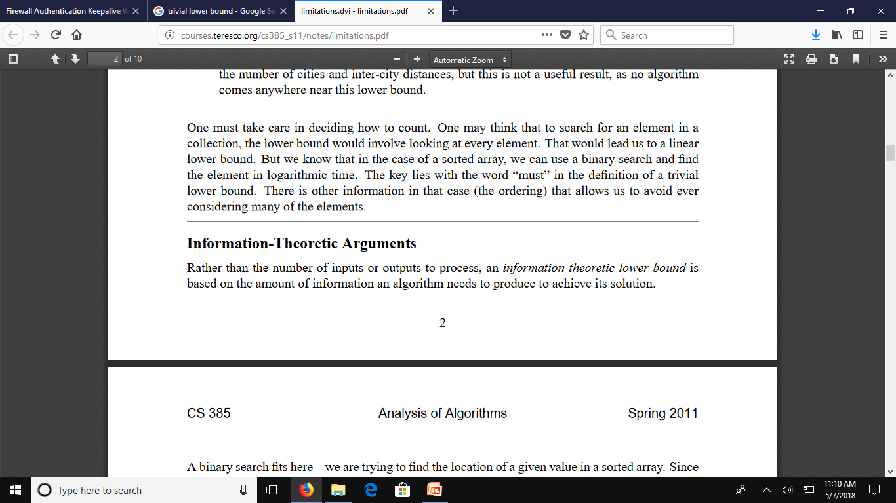
Trivial Lower Bounds (Cont..)
Conclusions
ay and may not be useful
be careful in deciding how many elements must be processed

Slide 9
Information-Theoretic Arguments (Decision Trees)
Decision tree —
a convenient model of algorithms involving comparisons in which:
internal nodes represent comparisons
leaves represent outcomes

Slide 10
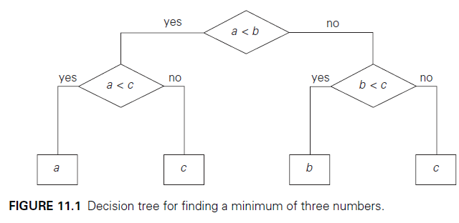
Decision Trees ( Example 1)

Slide 11
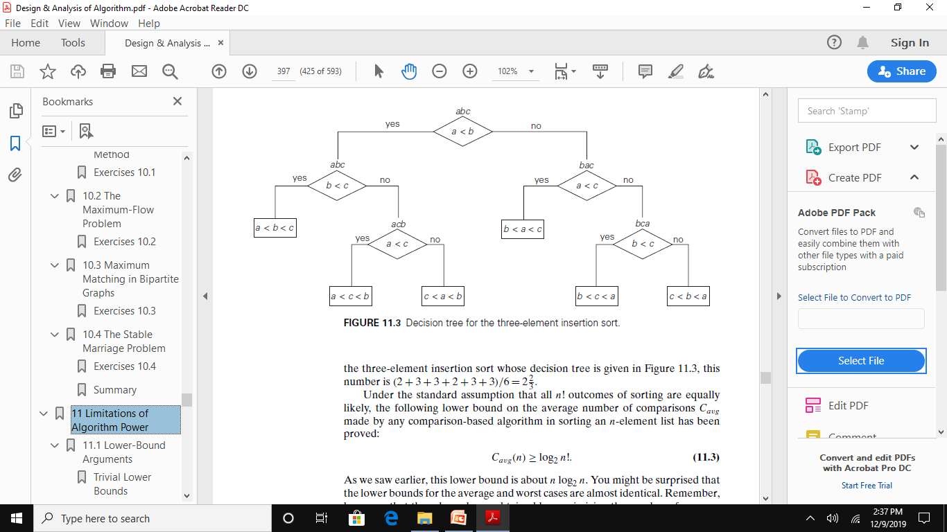
Decision Trees ( Example 2)

Slide 12
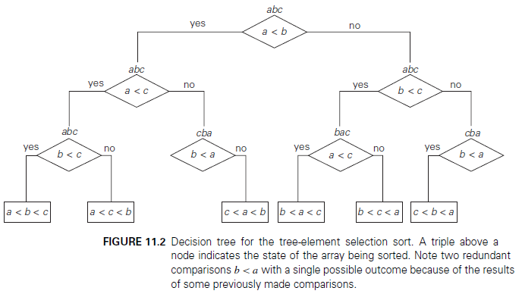
Decision Trees ( Example 3)

Slide 13
Decision Trees and Sorting Algorithms
Any comparison-based sorting algorithm can be represented by a decision tree
Number of leaves (outcomes) ≥ n!
Height of binary tree with n! leaves ≥ ⎡log₂n!⎤
Minimum number of comparisons in the worst case
≥ ⎡log₂n!⎤ for any comparison-based sorting algorithm
⎡log₂n!⎤ ≈ n log₂n
This lower bound is tight (merge sort)

Slide 14
Adversary Arguments
Adversary argument: a method of proving a lower bound by playing role of adversary that makes algorithm work the hardest by adjusting input
Example 1: “Guessing” a number between 1 and n with yes/no
questions
Adversary: Puts the number in a larger of the two subsets generated by last question
Example 2: Merging two sorted lists of size n
a₁ < a₂ < … < a_{n} and b₁ < b₂ < … < b_{n}
Adversary: a_{i} < b_{j} iff i < j
Output b₁ < a₁ < b₂ < a₂ < … < b_{n} < a_{n} requires 2n-1 comparisons
of adjacent elements

Slide 15
Lower Bounds by Problem Reduction
Idea:
If problem P is at least as hard as problem Q, then a lower bound for Q is also a lower bound for P.
Hence, find problem Q with a known lower bound that can be reduced to problem P in question.
Example: P is finding MST for n points in Cartesian plane Q is element uniqueness problem (known to be in Ω(nlogn))

Slide 16
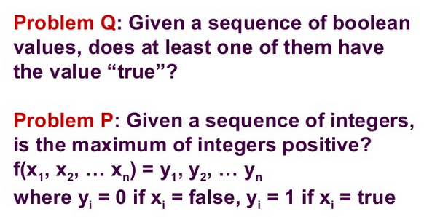
Example for Problem Reduction

Slide 17
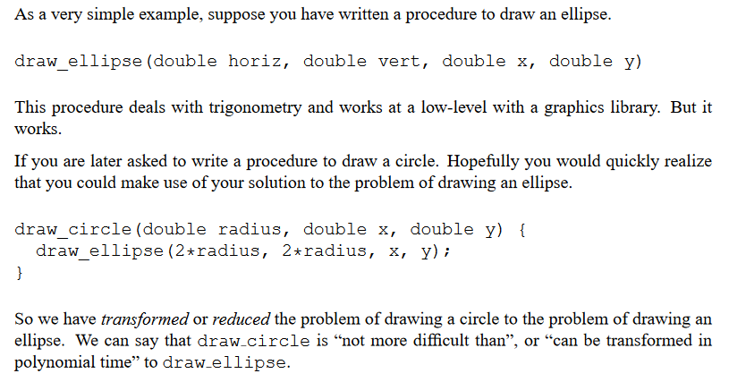
Example for Problem Reduction

Slide 18
Classifying Problem Complexity
Is the problem tractable, i.e., is there a polynomial-time (O(p(n)) algorithm that solves it?
Possible answers:
yes (give examples)
no
because it’s been proved that no algorithm exists at all (e.g., Turing’s halting problem)
because it’s been be proved that any algorithm takes exponential time
unknown

Slide 19
Polynomial Time Exponential Time
Linear search 0/1 Knapsack
Binary Search TSP
Insertion sort Sum of Subsets
Merge sort Graph coloring
Matrix multiplication Hamiltonian Cycle

Slide 20
Polynomial and Exponential running time
Polynomial running time
An algorithm is said to be solvable in polynomial time if the number of steps required to complete the algorithm for a given input is n^{k} for some non negative integer K
Exponential running time
An algorithm is said to be in exponential time if T(n) is upper bounded by 2^{poly(n)}

Slide 21
Non –Deterministic problems
Two important points:
When you are unable to solve the problem in polynomial time
Try to relate all the problems (Either solve it or relate it)
Show the similarities so that if one problem is solved all the problems can be solved
Write polynomial time non deterministic algorithms if you are unable to write polynomial time deterministic algorithms

Slide 22
How to write non deterministic algorithm?
Algorithm Nsearch(A, n, Key)
{
j= Choice();
if (key = A[j])
{
write(j);
success();
}
write(0);
failure();
}
Non deterministic
functions
Today : Once we don’t know how its working – Magic
Tomorrow: Once you know how its working – Technique (procedural or logic)

Slide 23
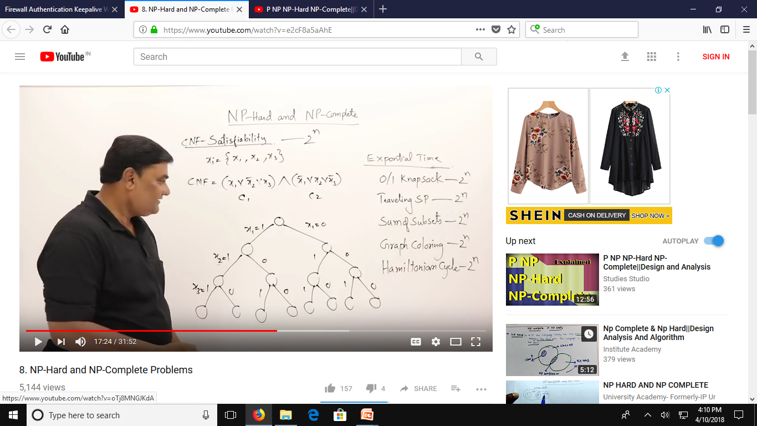

Slide 24
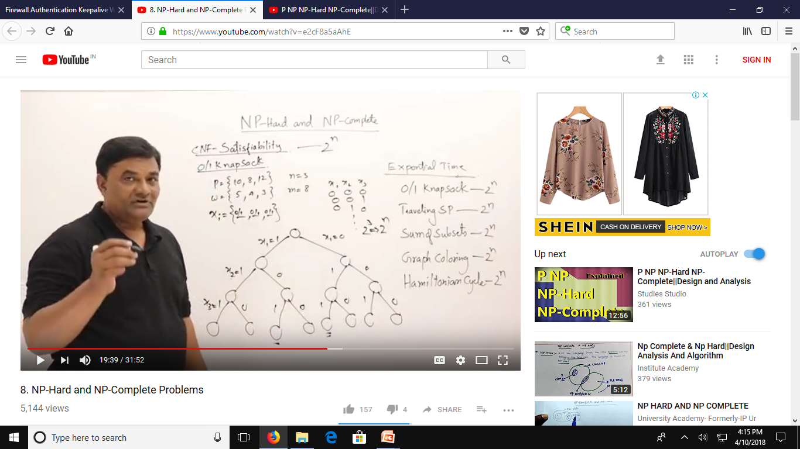

Slide 25
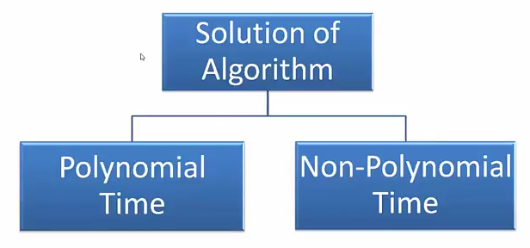
Solutions to algorithms
P-Class
NP-Class

Slide 26
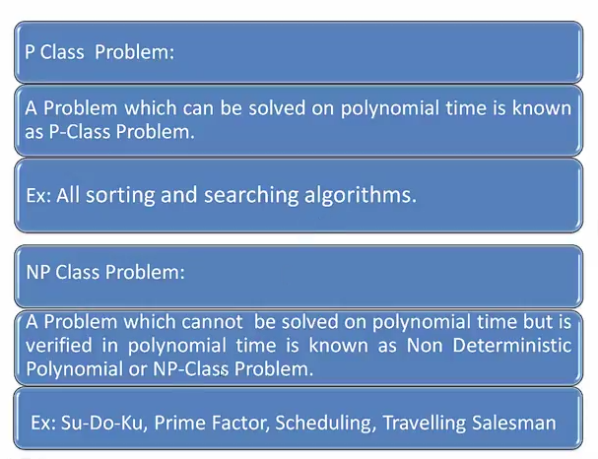

Slide 27
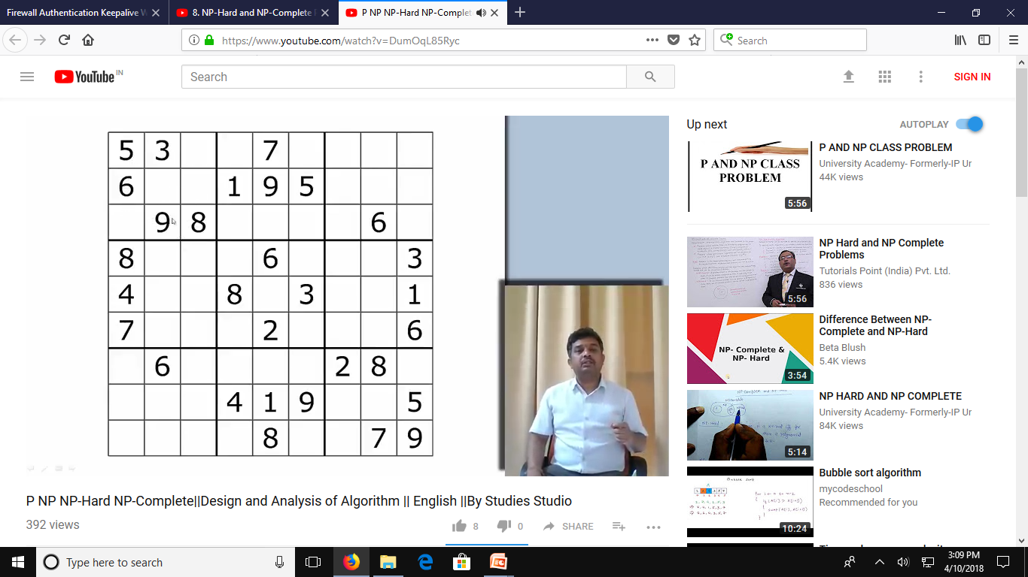
NP Problem: Su-Do-Ku

Slide 28
What problems are in NP?
Hamiltonian circuit existence
Partition problem: Is it possible to partition a set of n integers into two disjoint subsets with the same sum?
Decision versions of TSP, knapsack problem, graph coloring, and many other combinatorial optimization problems. (Few exceptions include: MST, shortest paths)
All the problems in P can also be solved in this manner (but no guessing is necessary), so we have:
P ⊆ NP
Big question: P = NP ?

Slide 29
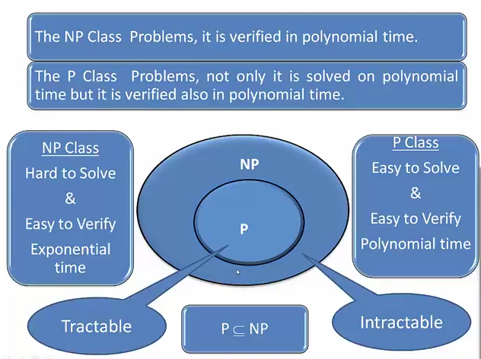

Slide 30
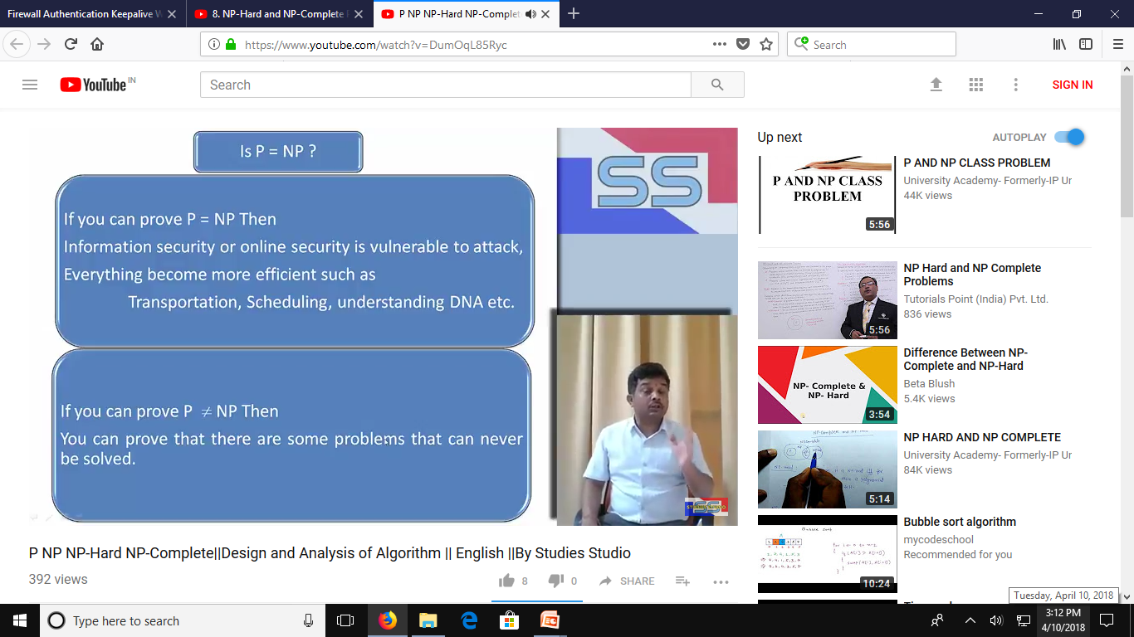

Slide 31
IS P=NP?
P = NP would imply that every problem in NP, including all NP-complete problems, could be solved in polynomial time
If a polynomial-time algorithm for just one NP-complete problem is discovered, then every problem in NP can be solved in polynomial time, i.e., P = NP
Most but not all researchers believe that P ≠ NP , i.e. P is a proper subset of NP

Slide 32
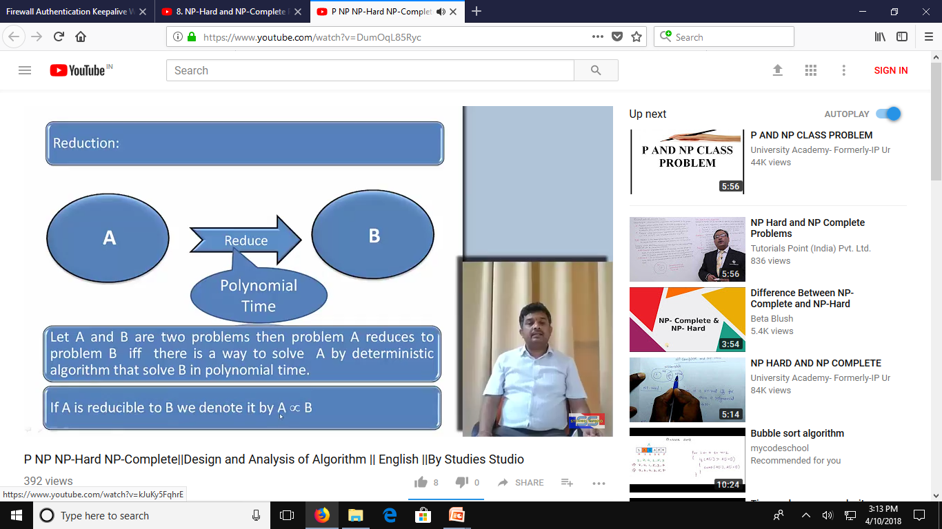

Slide 33
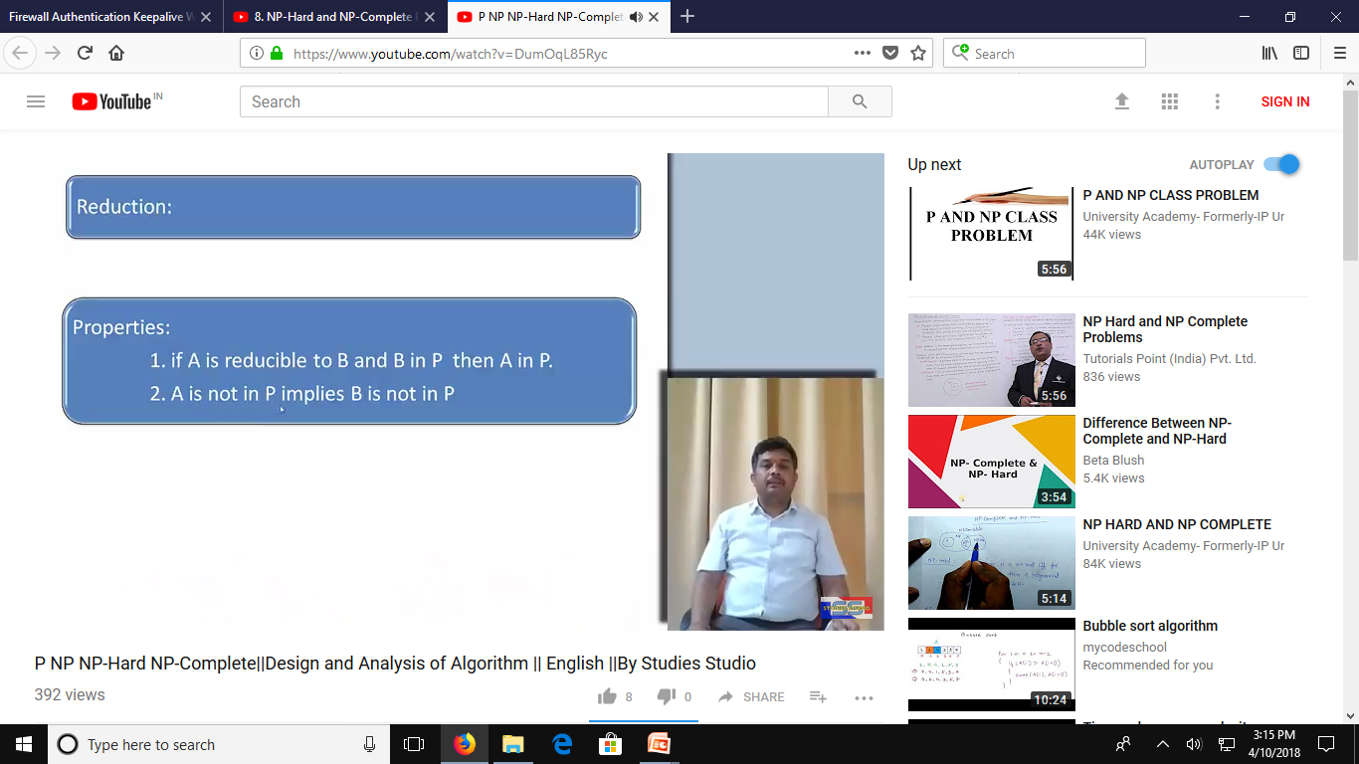

Slide 34
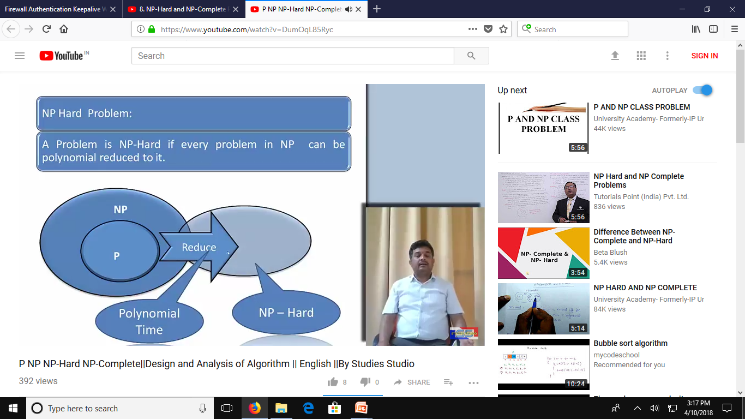
NP-Hard and NP-Complete problems

Slide 35
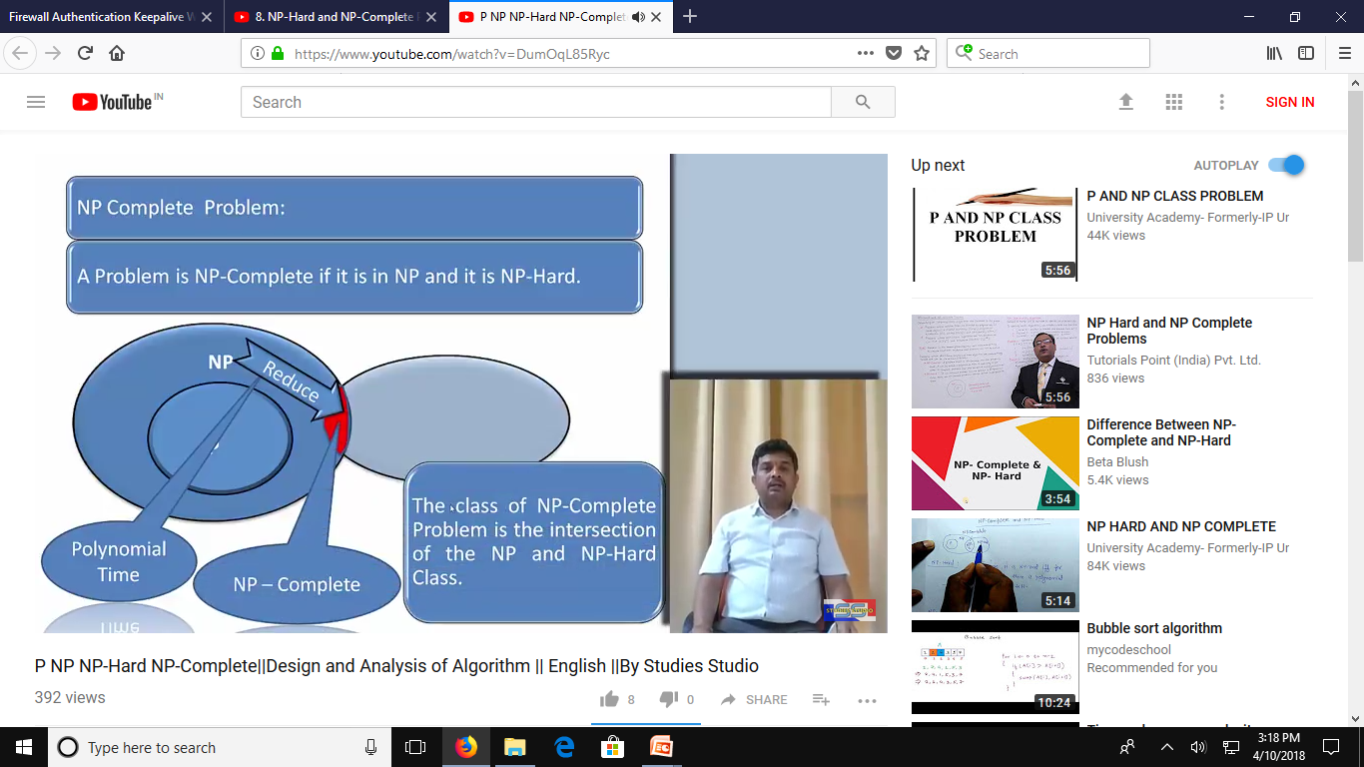
NP-Hard and NP-Complete (Cont..)

Slide 36
NP-Complete Problems
A decision problem D is NP-complete if it’s as hard as any
problem in NP, i.e.,
D is in NP
every problem in NP is polynomial-time reducible to D
Cook’s theorem (1971): CNF-sat is NP-complete

Slide 37
NP-Complete Problems(cont..)
Other NP-complete problems obtained through polynomial-
time reductions from a known NP-complete problem
Examples: TSP, knapsack, partition, graph-coloring and hundreds of other problems of combinatorial nature

Slide 38
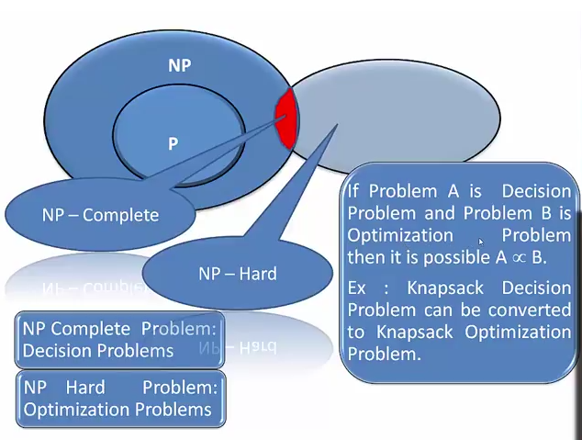
NP-Hard and NP-Complete (Cont..)

Slide 39
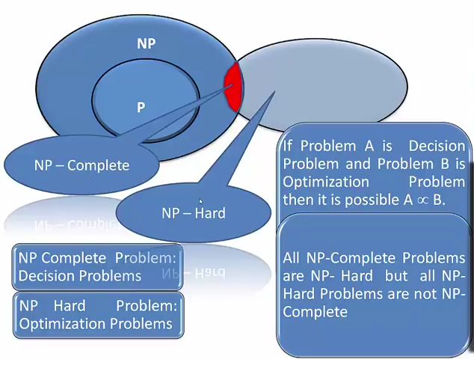
NP-Hard and NP-Complete (Cont..)

Slide 40
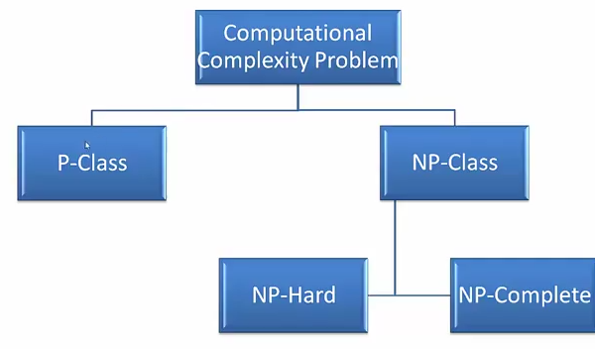
The complete classification of algorithms

